Slide 1
Predicting Alzheimer’s Disease Outcomes
Jonathan Ramos

Slide 2
The Problem
Alzheimer’s Disease (AD) diagnosis confirmation post-mortem
Neurofibrillary tracks
Abnormal plaque buildup and distribution
Relevant biomarkers associated with disease outcomes
Accessible
Sensitive, early detection
Correlate with disease outcomes
AD characterized by atrophy
Differences in MRI?

Slide 3
The Questions
Do participants characterized as demented have a smaller brain volume than participants characterized as nondemented?
Do participants characterized as demented have a higher atrophy than participants characterized as nondemented?
Can we use these features to help us build a model to predict disease outcomes?

Slide 4
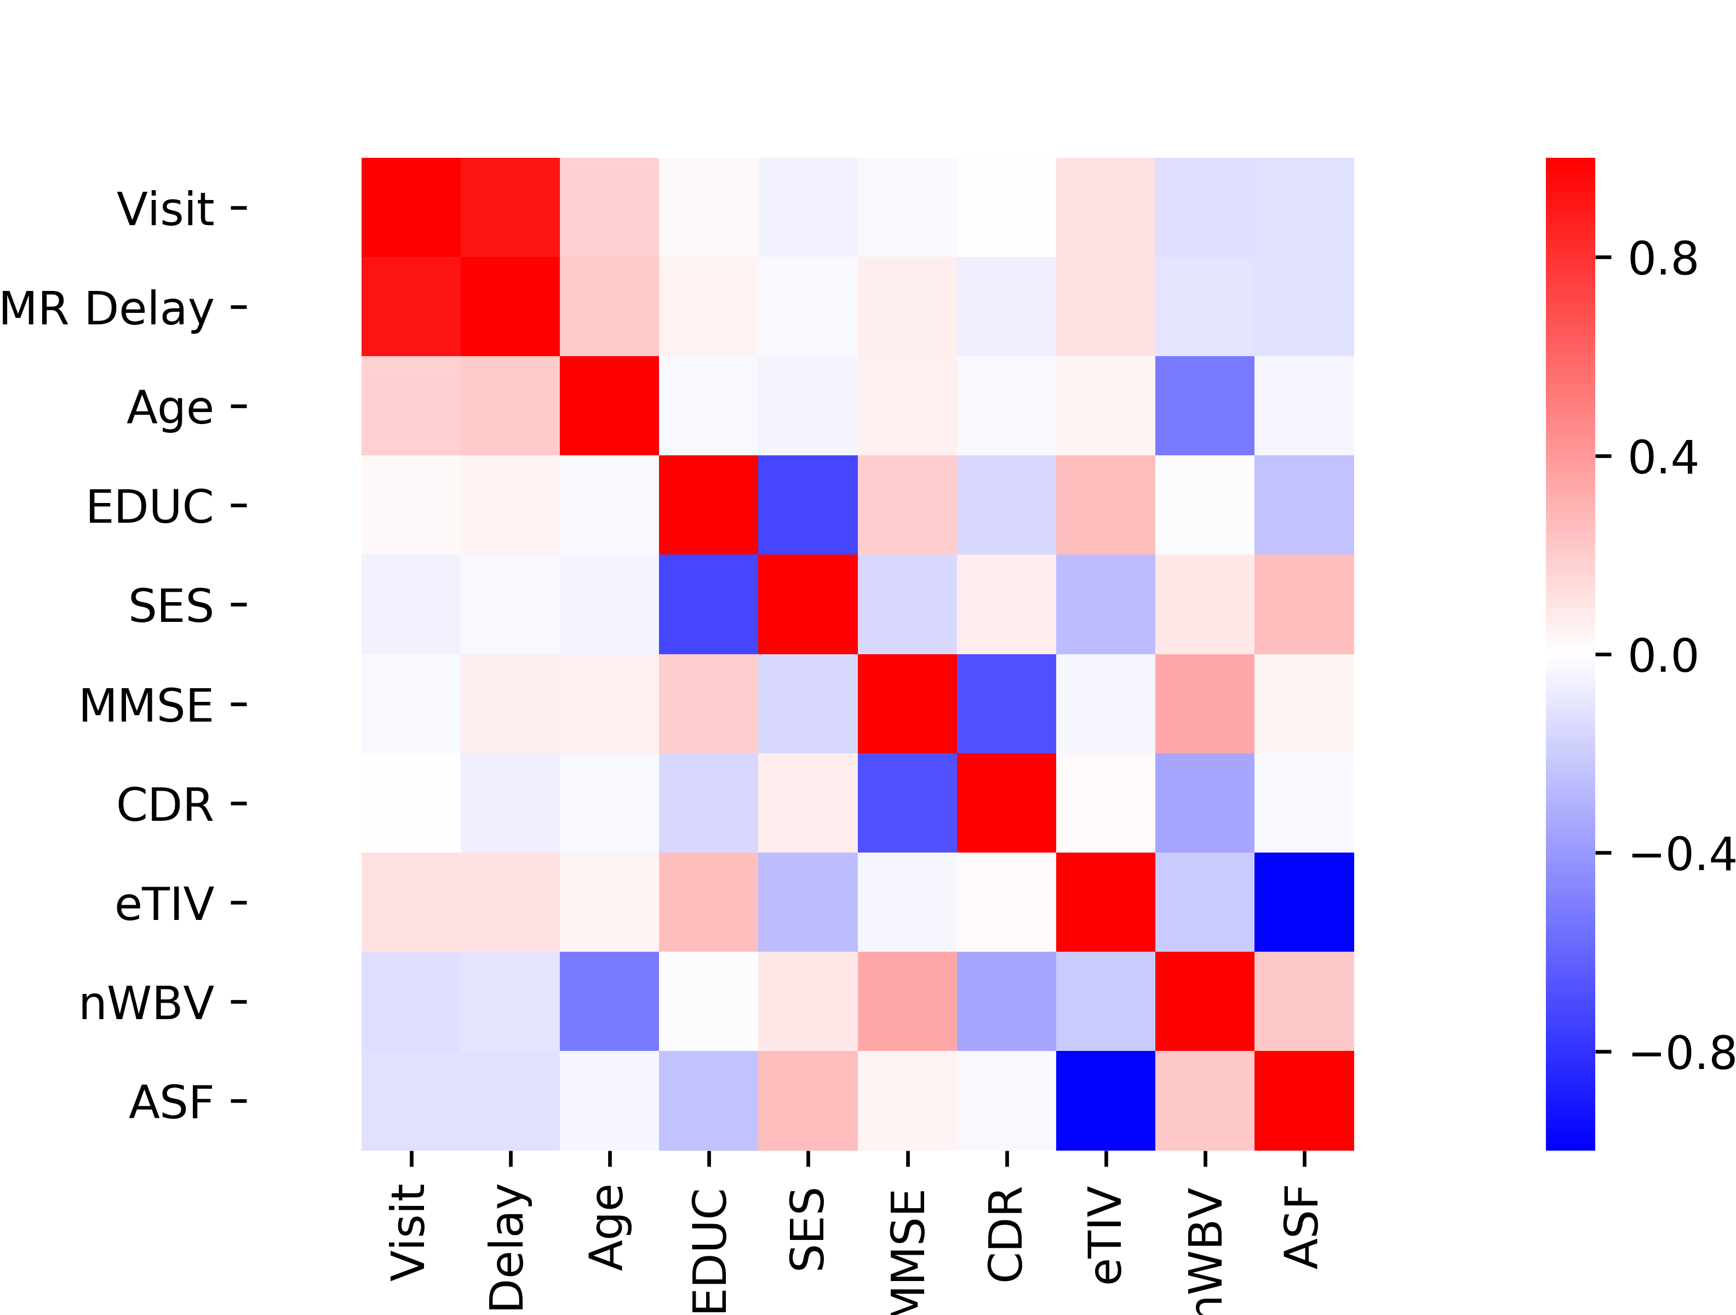
The Data
150 participants aged 60-96 were scanned 2 or more times with each visit separated by at least one year.
72 characterized as nondemented for the duration of the study
64 characterized as demented for the duration of the study
14 characterized as nondemented at the beginning of the study, then demented later
CDR: Clinical Dementia Rating
nWBV: Normalized Whole Brain Volume

Slide 5
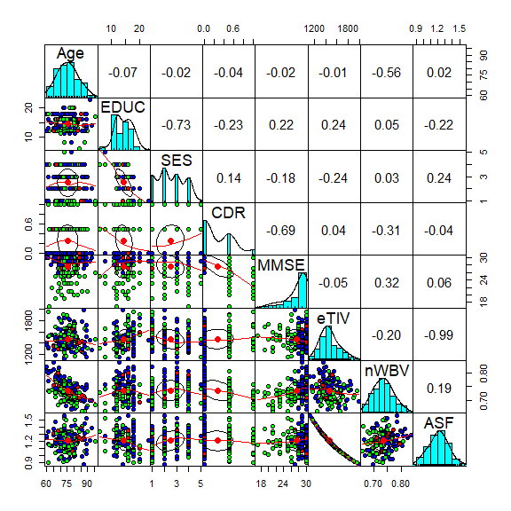
Green: Nondemented
CDR remained 0
Blue: Demented
CDR of at least 0.5
Red: Converted (early AD stages)
CDR was initially 0 but changed to 0.5 or greater

Slide 6
Data Cleaning and Preparation
Dropped unnecessary columns
Label columns, Visit, Handedness, ASF (multicollinearity)
Dealing with NaNs
NaNs only observed in SES and MMSE
Exploratory analyses suggest:
SES is well correlated with EDUC
MMSE is well correlated with CDR
Median replacement:
NaN in SES replaced with median SES based on EDUC level
NaN in MMSE replaced with median MMSE based on CDR score

Slide 7
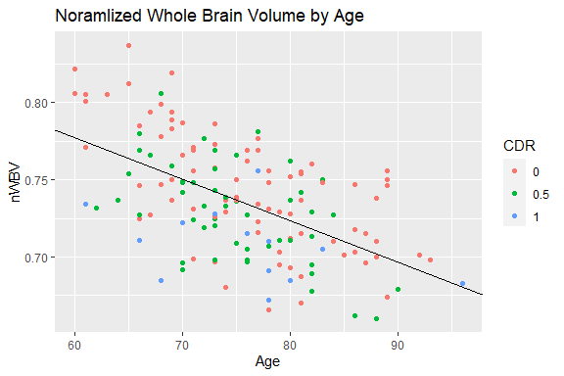
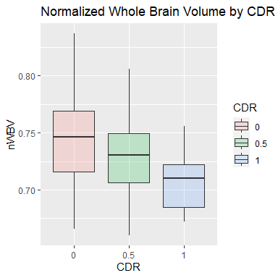
Question 1: Do brain volumes differ?
nWBV by CDR
*
*
*
Pearson’s r, p=1.18e-13
One way ANOVA, p=0.00012
Post-hoc t-tests: (alpha set to Bonferroni corrected p=0.016667)
0 vs 0.5 p=0.011,
0.5 vs 1 p=0.012,
0 vs 1 p=9.12e-5

Slide 8
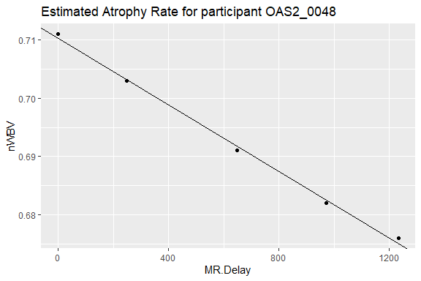
Question 2: Do atrophy rates differ?
Estimate atrophy rate via linear regression
Take the nWBV measurements over MR.Delay (unit in days)
Take the slope from linear regression
Repeat for each participant
Stitch together a new data frame containing
A new atrophy.rate column
Only the most recent data per participant

Slide 9
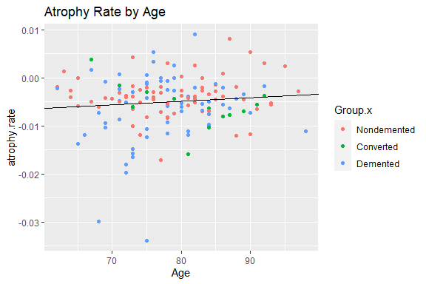
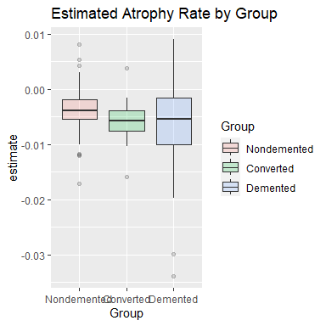
Question 2: Do atrophy rates differ?
*
Pearson’s r, p=0.2419
one-way ANOVA p=0.02407
Nondemented vs Convertd p=0.1308
Converted vs Demented p=0.6438
Demented vs Nondemtned p=0.009001

Slide 10
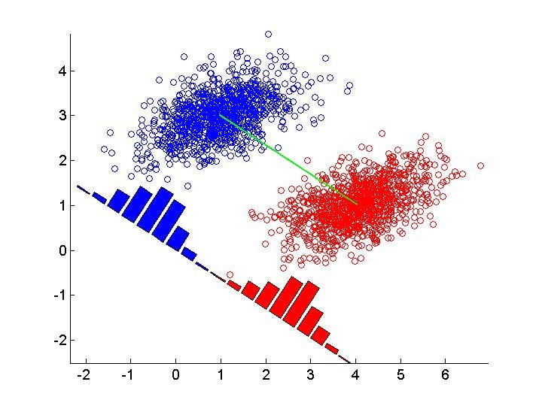

Question 3: Predicting AD outcomes
Linear Discriminant Analysis
Supervised learning
Dimensionality Reduction
k-1 components
Maximizing class separability
Maximize the distance between means
Minimize variance of each class
$$\max_{v:\left\|v\right\|=1}{\frac{{\left(μ_{1}−μ_{2}\right)}^{2}}{{s_{1}}^{2}+{s_{2}}^{2}}}$$
$$μ_{j}=v^{T}m_{j}, j=1,2$$

Slide 11
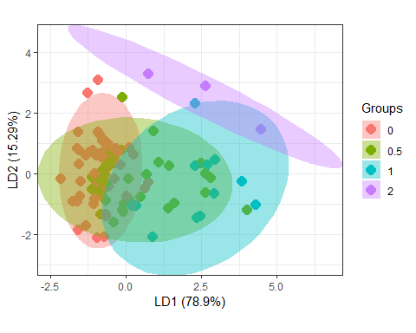
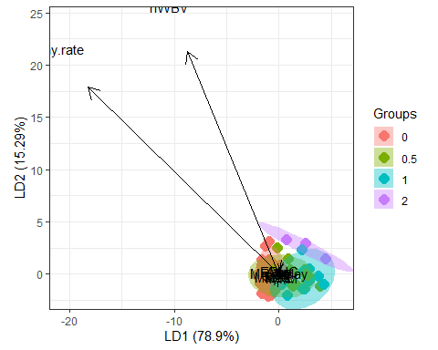
Question 3: Linear Discriminant Analysis
Train accuracy: 68.57%
Test accuracy: 64.44%
P-value = 0.0007966,
(Acc > No information rate)
Train
Test
 | 0 | 0.5 | 1 | 2
0 | 51 | 20 | 0 | 0
0.5 | 4 | 10 | 3 | 0
1 | 0 | 5 | 8 | 0
2 | 0 | 0 | 1 | 3
 | 0 | 0.5 | 1 | 2
0 | 18 | 8 | 1 | 0
0.5 | 0 | 9 | 2 | 0
1 | 0 | 1 | 2 | 0
2 | 0 | 0 | 4 | 0

Slide 12

Question 3: Predicting AD outcomes
Decision trees highly sensitive to training data, might fail to generalize
So we train many random trees
Bootstrap data
Many new datasets are generated by random row selection with replacement
Reduces sensitivity to original data
Random feature subset selection to train
Reduces correlation between trees
Majority vote of all trees
Bootstrapping + Aggregating = Bagging

Slide 13
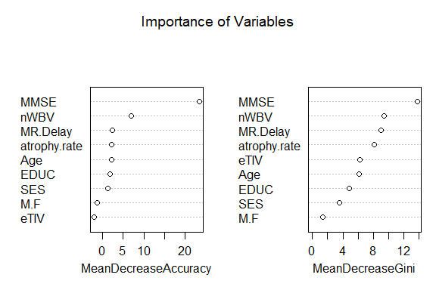
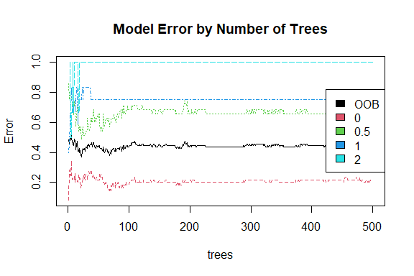
Question 3: Random Forest
Train
Test
 | 0 | 0.5 | 1 | 2
0 | 44 | 11 | 0 | 0
0.5 | 18 | 10 | 7 | 0
1 | 0 | 9 | 3 | 0
2 | 0 | 2 | 1 | 0
 | 0 | 0.5 | 1 | 2
0 | 14 | 5 | 2 | 0
0.5 | 4 | 13 | 5 | 1
1 | 0 | 0 | 2 | 0
2 | 0 | 0 | 0 | 0
Train accuracy: 54.29%
Test accuracy: 64.44%
P-value = 0.0007966,
(Acc > No information rate)

Slide 14
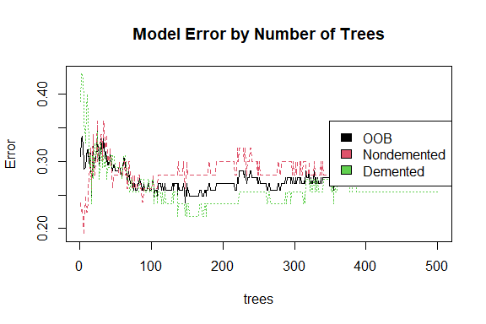
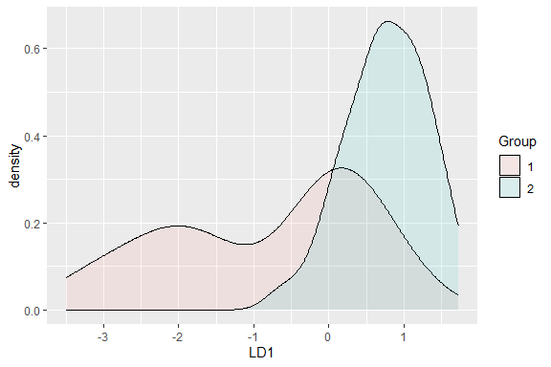
Question 3: Can we Improve the model?
Let’s consider just trying to classify if a patient had Dementia at all, a binary model where nondemented = 2, demented =1 (positive class is1)
 | Train | Test
Sensitivity | 60.00% | 74.07%
Specificity | 94.55% | 100.0%
Accuracy | 78.1% | 84.44%
Train
Test
 | Train | Test
Sensitivity | 60.00% | 81.48%
Specificity | 74.55% | 72.22%
Accuracy | 73.33% | 77.78%
Train
Test
 | 1 | 2
1 | 30 | 3
2 | 20 | 52
 | 1 | 2
1 | 20 | 0
2 | 7 | 18
 | 1 | 2
1 | 36 | 14
2 | 14 | 41
 | 1 | 2
1 | 22 | 5
2 | 5 | 13

Slide 15
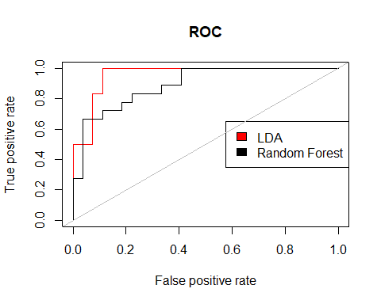
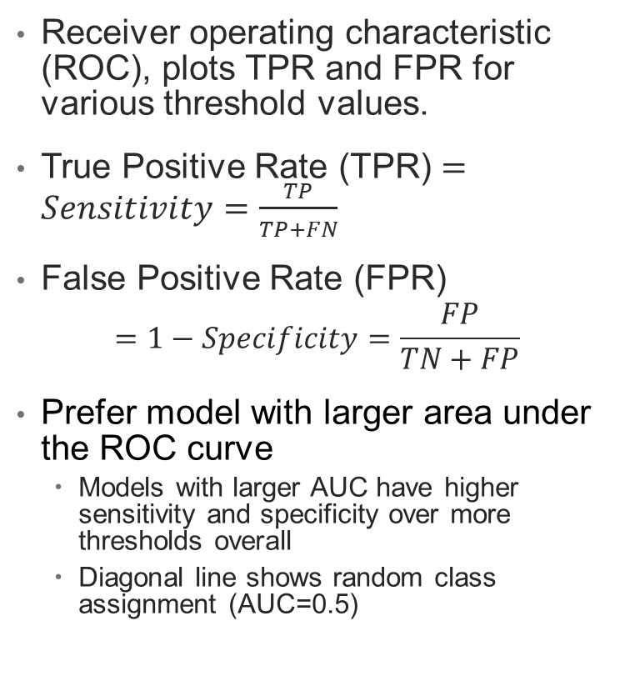
Area under the Curve
Receiver operating characteristic (ROC), plots TPR and FPR for various threshold values.
True Positive Rate (TPR) $=Sensitivity=\frac{TP}{TP+FN}$
False Positive Rate (FPR)
$$=1−Specificity=\frac{FP}{TN+FP}$$
Prefer model with larger area under the ROC curve
Models with larger AUC have higher sensitivity and specificity over more thresholds overall
Diagonal line shows random class assignment (AUC=0.5)
LDA AUC: 0.957
RF AUC: 0.893

Slide 16
Conclusion
Participants characterized as demented have a smaller nWBV
Participants characterized as demented do not have the same atrophy rate as participants characterized as non demented.
Participants determined to be in early stages of AD fall in between
Both models struggle to differentiate between more subtle differences in CDR (nondemented vs slight vs mild vs moderate dementia CDR = 0, 0.5, 1, 2 respectively).
When classifying whether or not a participant had any dementia at all, LDA gives the best results at 89.47% accuracy
Overall AD is a very complex disease that depends on many different factors, notably MMSE, nWBV and estimated atrophy rate. We cannot fully rely on models to deliver accurate diagnoses, but these studies demonstrate that derived metrics from MRI may be an informative component when considering diagnoses.

Slide 17
Data Source
Marcus DS, Fotenos AF, Csernansky JG, Morris JC, Buckner RL. Open access series of imaging studies: longitudinal MRI data in nondemented and demented older adults. J Cogn Neurosci. 2010 Dec;22(12):2677-84. doi: 10.1162/jocn.2009.21407. PMID: 19929323; PMCID: PMC2895005.
Accessible via Kaggle

Slide 18
References
1. Gonzalez AE, Jorgensen ET, Ramos JD, Harkness JH, Aadland JA, Brown TE, Sorg BA. Impact of Perineuronal Net Removal in the Rat Medial Prefrontal Cortex on Parvalbumin Interneurons After Reinstatement of Cocaine Conditioned Place Preference. Front Cell Neurosci. 2022 Jul 28;16:932391. doi: 10.3389/fncel.2022.932391. PMID: 35966203; PMCID: PMC9366391.
2. Kehoe EG, McNulty JP, Mullins PG, Bokde AL. Advances in MRI biomarkers for the diagnosis of Alzheimer's disease. Biomark Med. 2014;8(9):1151-69. doi: 10.2217/bmm.14.42. PMID: 25402585.
3. Marcus DS, Wang TH, Parker J, Csernansky JG, Morris JC, Buckner RL. Open Access Series of Imaging Studies (OASIS): cross-sectional MRI data in young, middle aged, nondemented, and demented older adults. J Cogn Neurosci. 2007 Sep;19(9):1498-507. doi: 10.1162/jocn.2007.19.9.1498. PMID: 17714011.
4. Scarlett JM, Hu SJ, Alonge KM. The "Loss" of Perineuronal Nets in Alzheimer's Disease: Missing or Hiding in Plain Sight? Front Integr Neurosci. 2022 May 25;16:896400. doi: 10.3389/fnint.2022.896400. PMID: 35694184; PMCID: PMC9174696.
5. Silbert LC, Quinn JF, Moore MM, Corbridge E, Ball MJ, Murdoch G, Sexton G, Kaye JA. Changes in premorbid brain volume predict Alzheimer's disease pathology. Neurology. 2003 Aug 26;61(4):487-92. doi: 10.1212/01.wnl.0000079053.77227.14. PMID: 12939422.

Slide 19
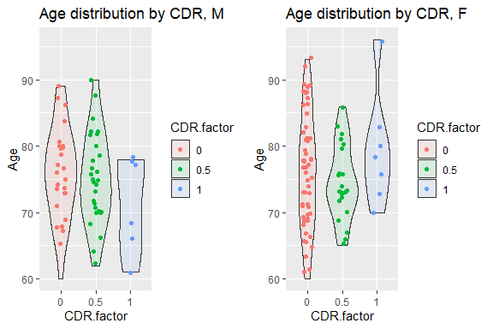
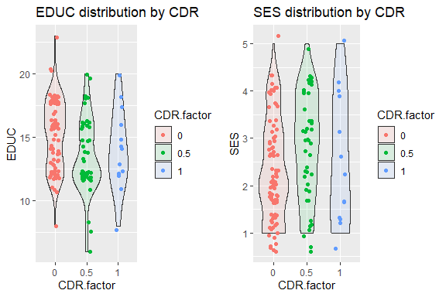
Supplemental Figures

Slide 20
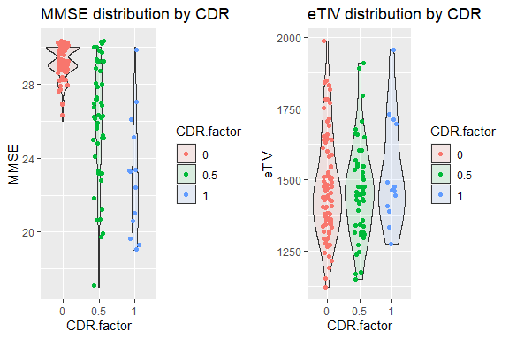
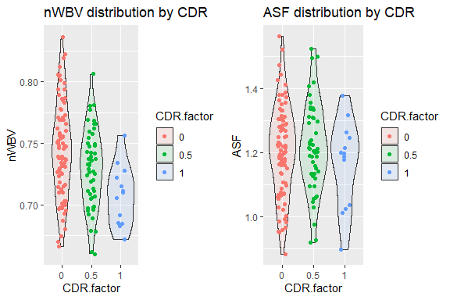
Supplemental Figures

Slide 21
Thank you! Questions?

Slide 22
Formatting figures for paper
Figure 1
A
B
C
D

Slide 23
Formatting figures for paper
Figure 2
A
B
nWBV by CDR
Figure 3
*
*
*
Figure 4
Atrophy rate by Group
A
B
*

Slide 24
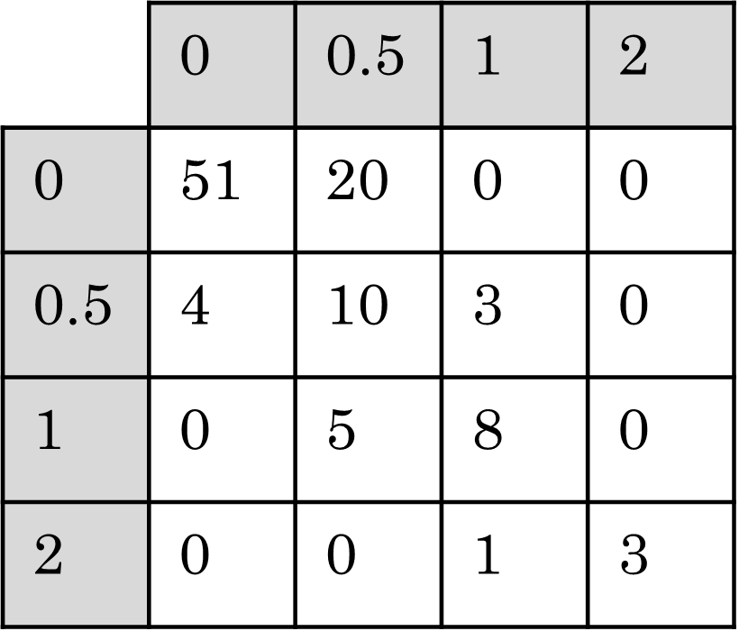
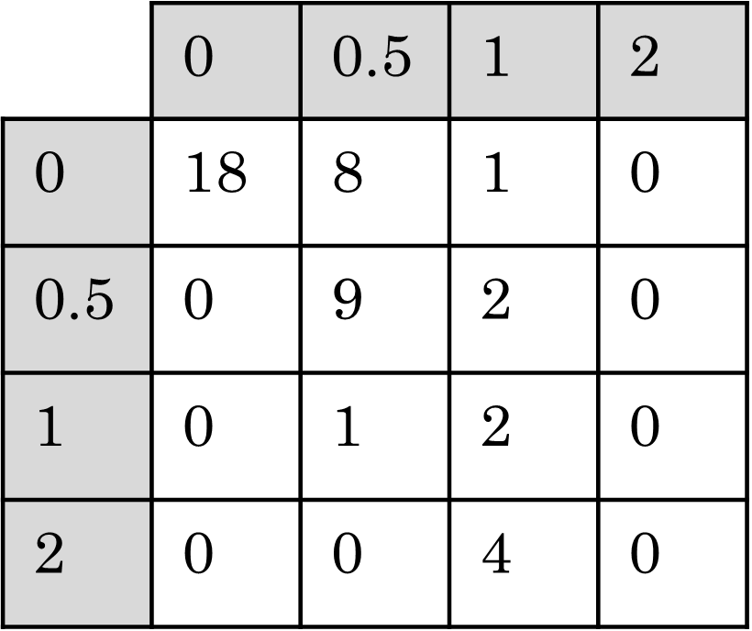
Formatting figures for paper
Figure 5
Figure 6
B
A
B
A
nWBV
Atrophy rate
C
Train
Test
C
Train
Test

Slide 25
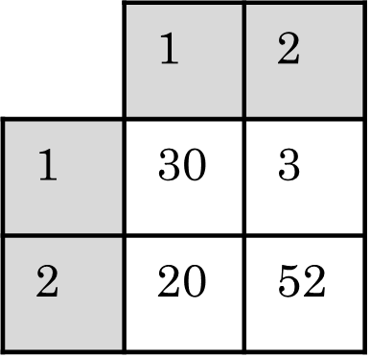

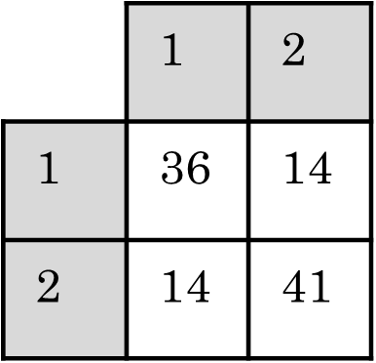
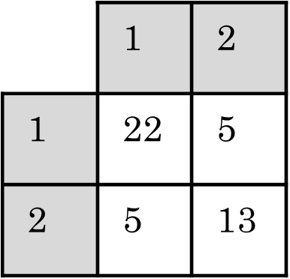
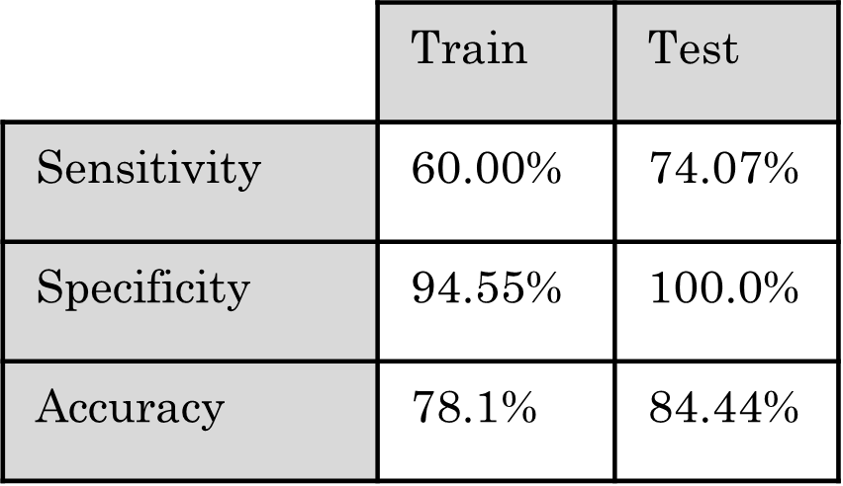

Formatting figures for paper
Figure 7
Figure 8
A
B
C
Train
Test
D
Train
Test

